Slide 1
COVID19 Testing Management System
REBECCA SULTANA
Project Proposal
CSE-0318|Software Engineering Lab
Dept. Of CSE
State University Of Bangladesh
Submitted To: Khan Md. Hasib (Lecturer)
Dept. of CSE
SUB.
Aug 05, 2021

Slide 2

0verview
Introduction
Development Tools
Module
Module Specification

Slide 3
Introduction
This project is providing online Covid-test system that provides test reports online.

Slide 4
Introduction to Development Tools
Create module I am using Php, MySQL.
User interface design with HTML, CSS.
Web browser requirement such as Mozilla / Chrome / Edge (anyone).
Using XAMPP / Wamp (anyone) for run program.

Slide 5
Module
In this project, There will be two modules –
Admin
User (patients)

Slide 6
Admin Module
Admin is the super user of the website who can manage everything. Admin can login through login page:
Dashboard
Report
Notification

Slide 7
User Module
User can visit the application using a URL:
Testing
Report
Dashboard

Slide 8

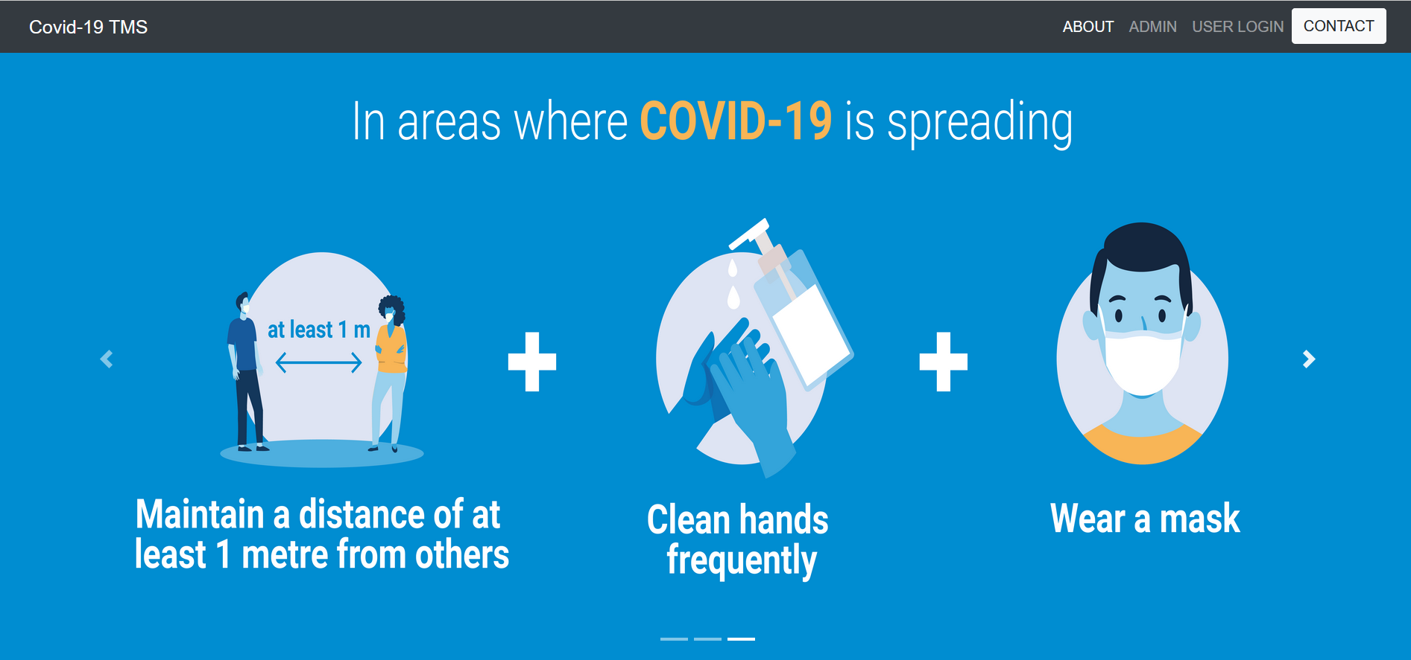
Project front page

Slide 9
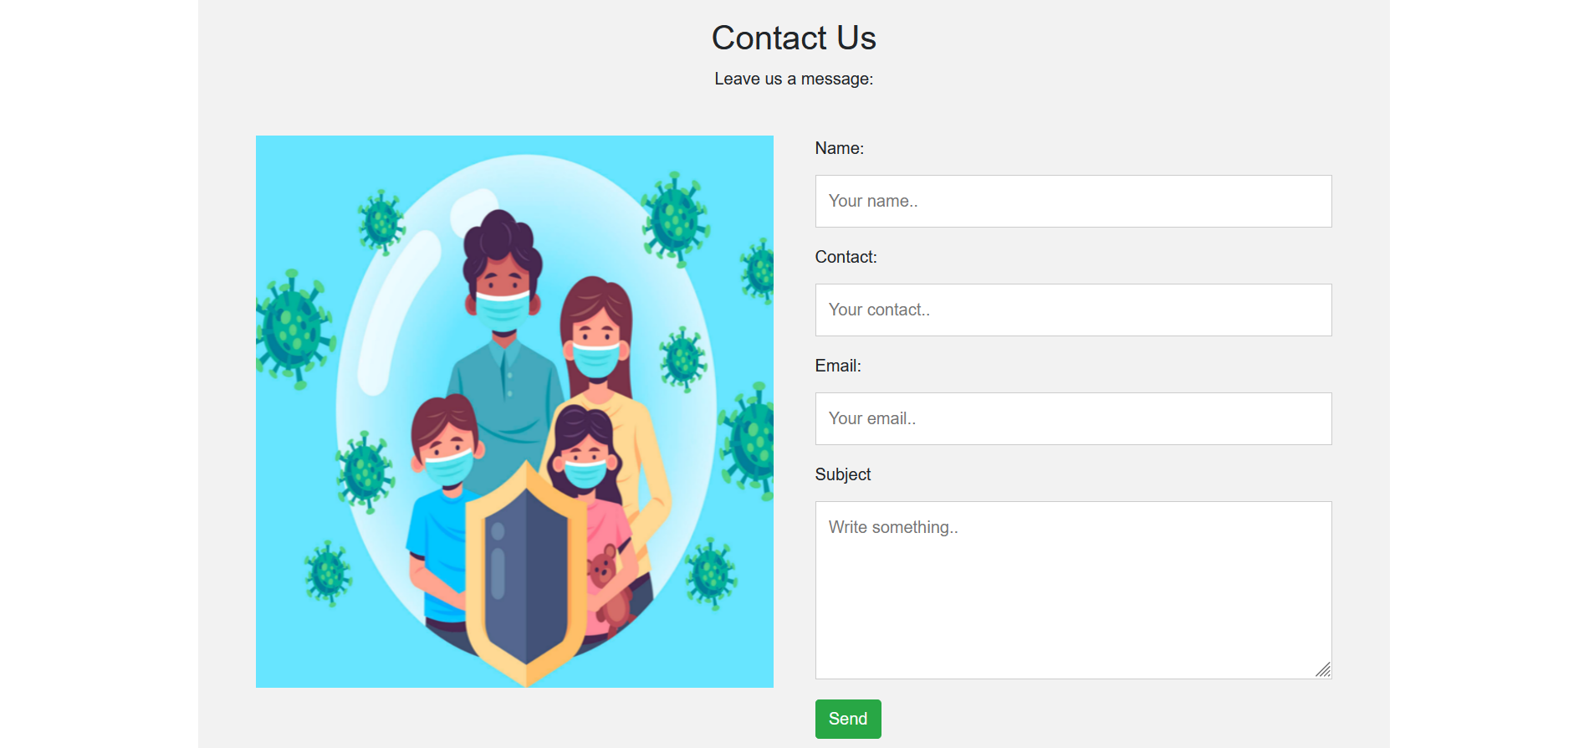

Project Demo cont..

Slide 10

THANK YOU

